Slide 1
Presentation on Brian’s 3rd subject page
By Leon

Slide 2

Table of contents
content
  Pros and cons
  Layout
  Text Layout
  Content
  Minor improvements

Slide 3
Pros and cons
PROs
  Excellent Layout
  Great color
  Button are cool
Cons
  Could writes more about the actual social study course
  Interesting article and page choice

Slide 4
Layout

Slide 5
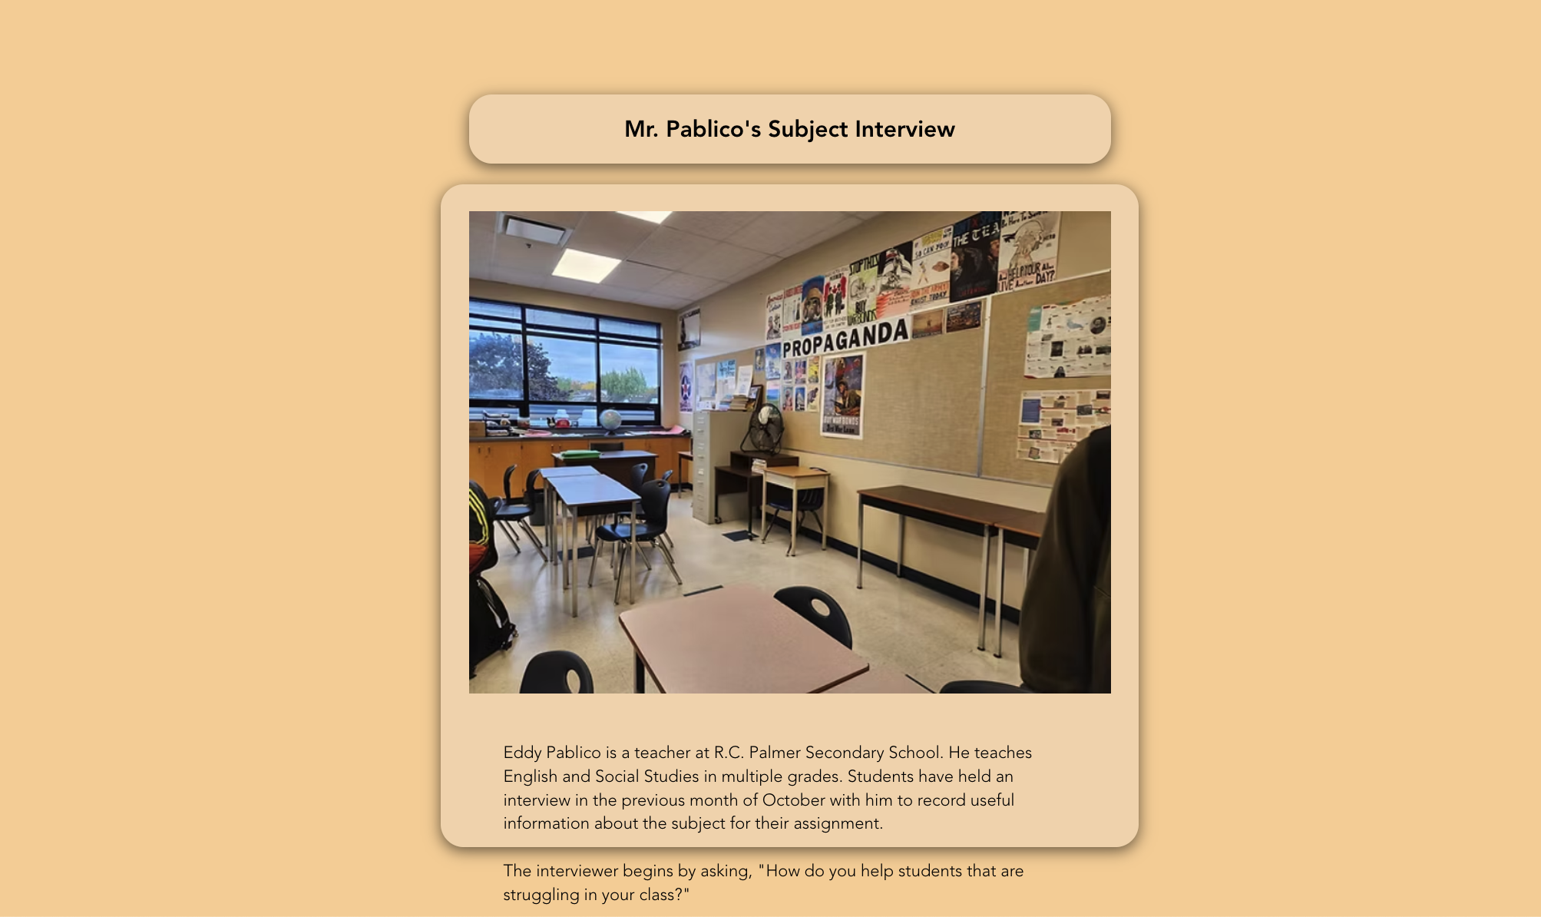
Layout : coloring
The color choices is great
Great contrast

Slide 6
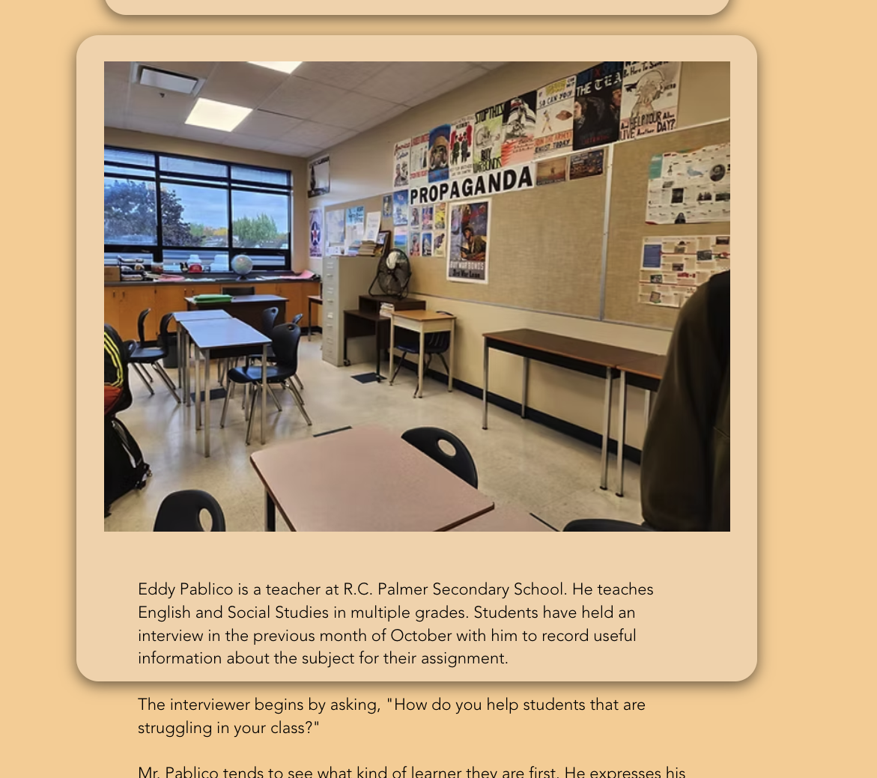

Layout: images/ icons
Great images quality
Good alignment

Slide 7
Layout: images/ icons
Great images quality
Good alignment
Separates text well
Could fix the pic frame

Slide 8
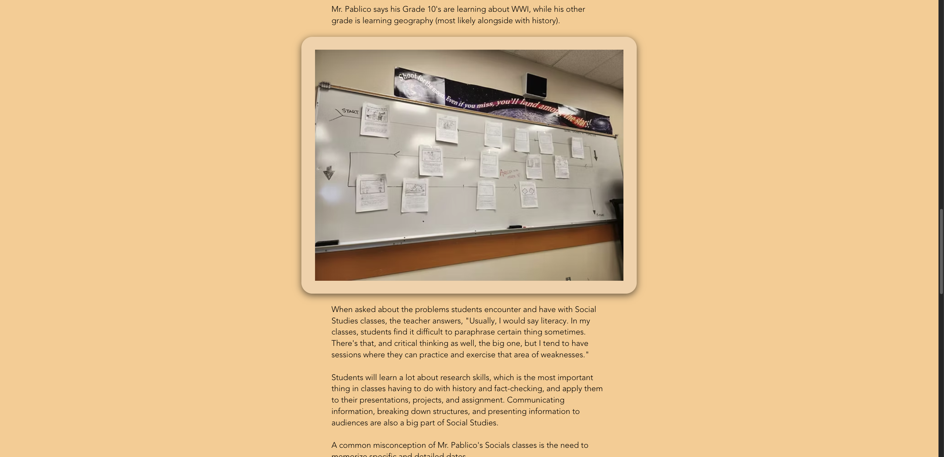
Layout
Good balance of white space
Great hierarchy

Slide 9
TEXT LAYOUT

Slide 10

Typography
Highly readable fronts
Clear hierarchy
Correct sizing

Slide 11
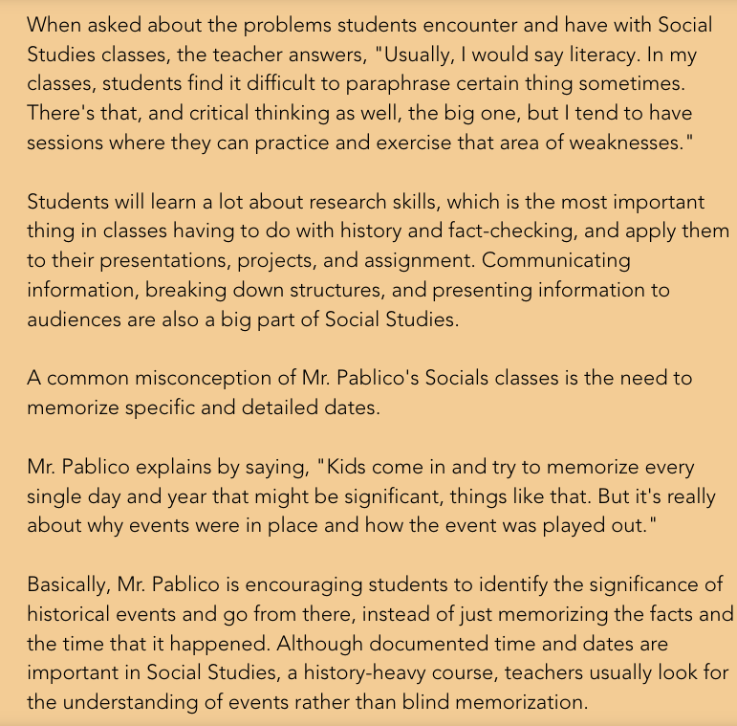
Alignment/ tone
Text is aligned
Good title length
Great contrast
Clear writing
Could use some more bullet points

Slide 12
Content

Slide 13

Title
Title is clear
Reflects the central idea

Slide 14
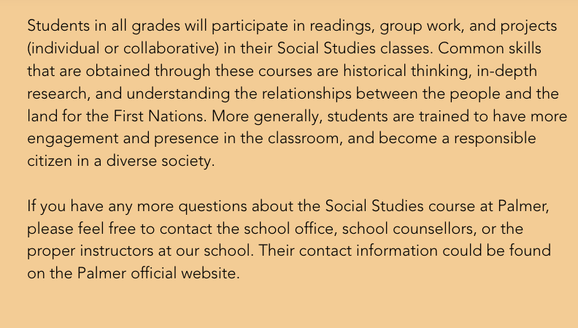
Intro / conclusion
Missing intro
Very minor conclusion

Slide 15
Body def and importance
Mention some topics but lacks a lot of detail
Provides minimal explanation about subject importance

Slide 16

Outcomes/ recent developments
NO learning out comes or career options
NO examples

Slide 17
Style and format
Tone is formal and informative
Minor jargon

Slide 18
SOME MINOR Improvement

Slide 19
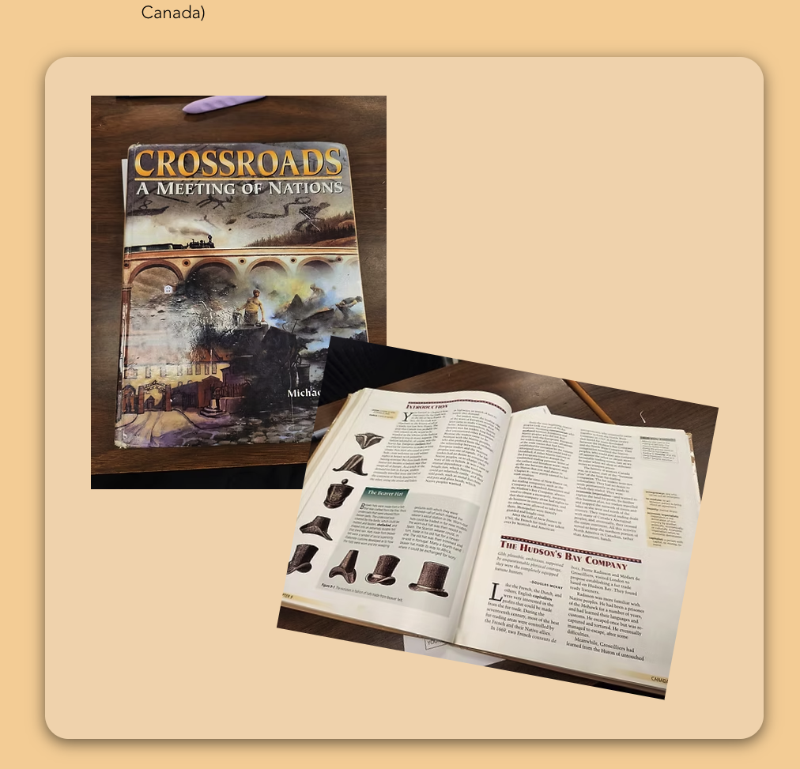

Slide 20
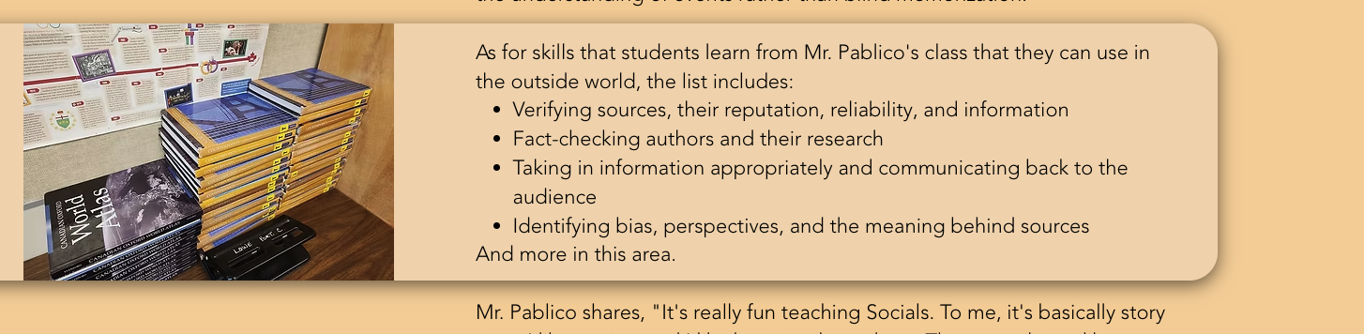

Slide 21
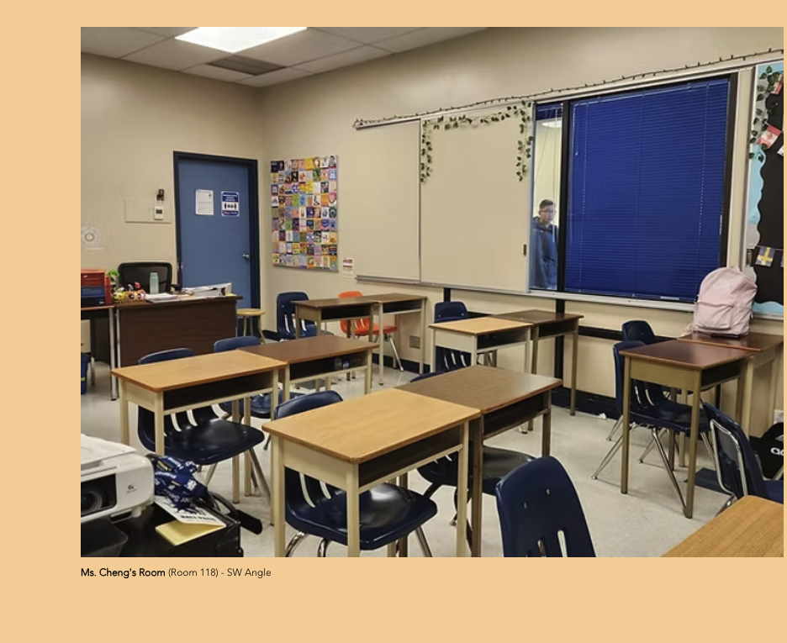

Slide 22
THE END

